Slide 1
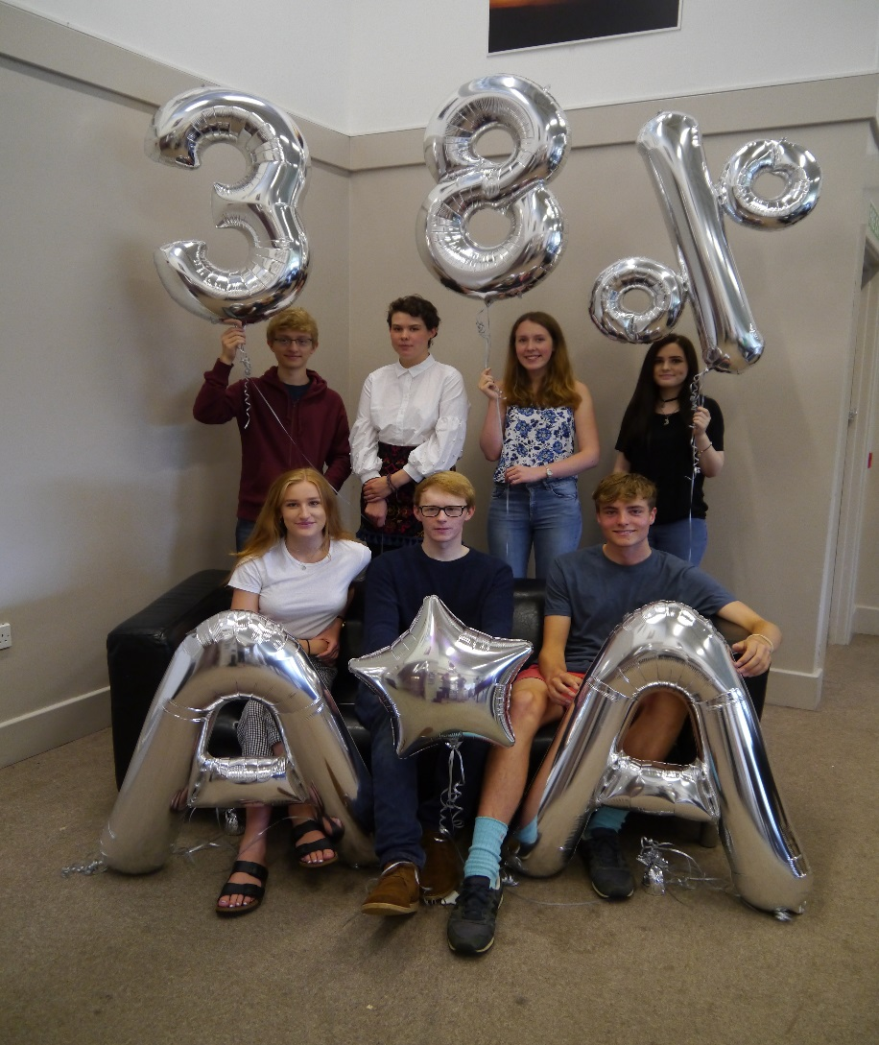
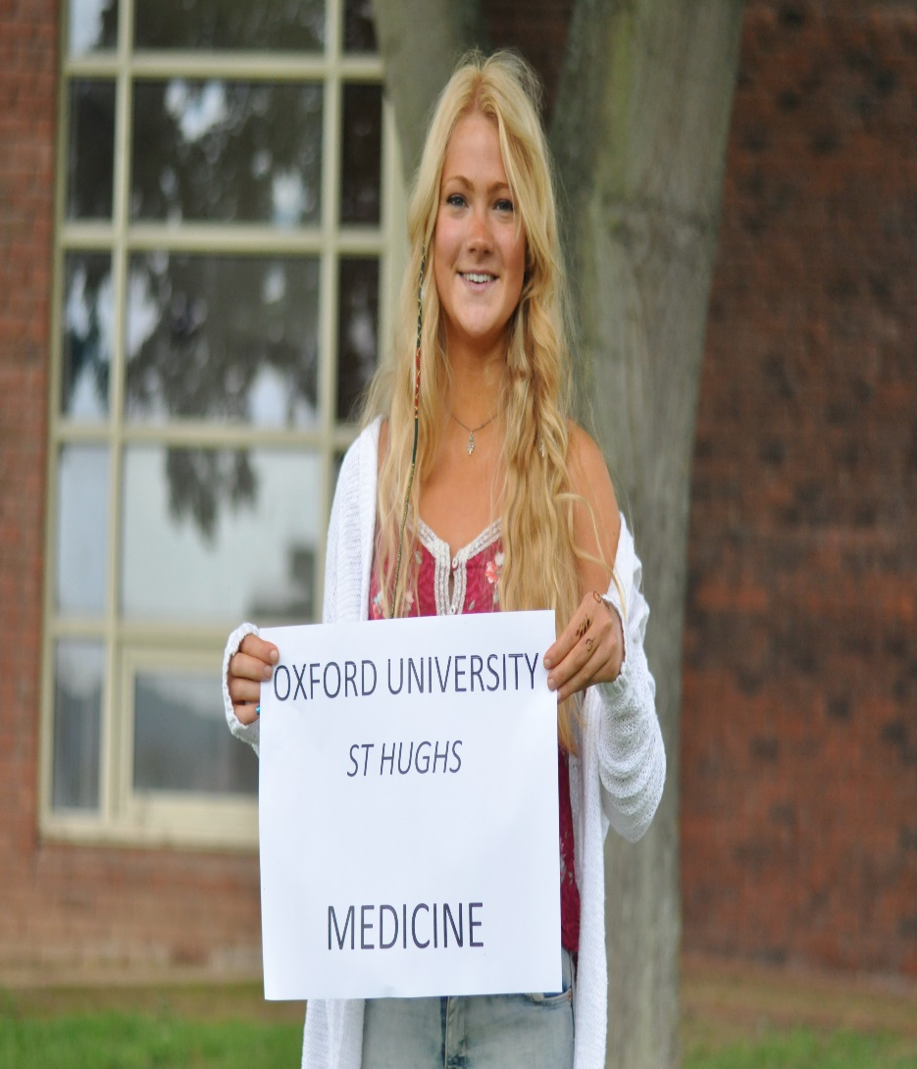
John Masefield Sixth Form
Competitive University Courses

Slide 2
What is The Russell Group
Formed in 1994 at a meeting convened in Russell Square.
An association of 24 major research universities, committed to maintaining the highest standards of research and education.
Represents only about 10% of the higher education sector but in 2010 60% of the best (world –leading) research was completed there.

Slide 3
The Russell Group
Birmingham Bristol
Cambridge Cardiff
Durham Edinburgh
Exeter Glasgow
Imperial College King’s College
Leeds Liverpool
LSE Manchester
Newcastle Nottingham
Queen Mary Queen’s University Belfast
Oxford Sheffield
Southampton UCL
Warwick York
Some great universities (Bath, Loughborough, Lancaster, Sussex etc.) not on list
1 in 3 JMHS Sixth formers usually secure a place in Russell Group universities

Slide 4
What kind of A Level grades will I need?
English at Sheffield AAB
Chemistry at Durham A*AA
AAA to A*AA at Oxford with a few at A*A*A.
At least AAA in most cases for Medicine.
Excellent GCSE’s still important and some courses will have specific requirements eg medical courses.
But there are other degree courses with lower requirements than this

Slide 5

What do Russell Group say about
A Level subject choices ?
http://www.russellgroup.ac.uk/
http://www.russellgroup.ac.uk/media/5457/informed-choices-2016.pdf
Excellent pdf downloadable guide to subject choices!

Slide 6
Facilitating subjects
Some A level subjects are more frequently required than others – ‘Facilitating subjects’
Maths & Further Maths, Biology, Chemistry, Physics, Geography, History, modern languages, English.
For Russell Group at least one and sometimes two facilitating subjects must normally have been taken
However some courses have no specific subject requirements or identify subjects as desirable but not essential.

Slide 7
UCAS Medical Applications data
Applicants 21,932 (2016)
Receive offer 37% of applicants
No offer 63% of applicants
One offer 21%
Two offers 10% (One of our students this year)
Three offers 4%
Four offers 1% (One of students in 2016)

Slide 8

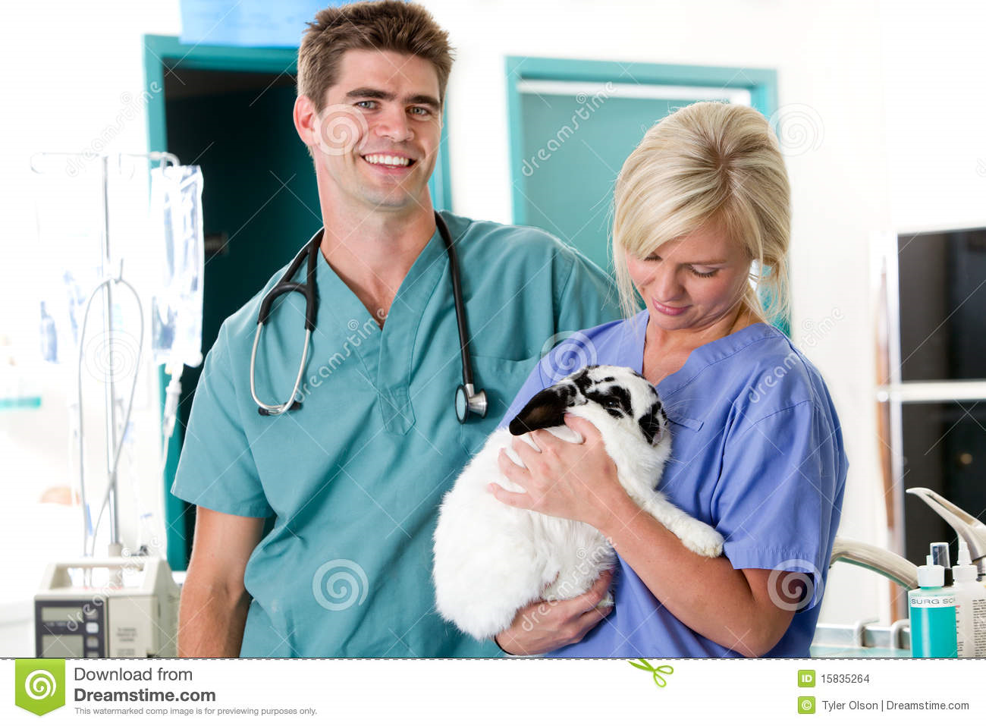
Medicine and
Veterinary
Key to success :
You need a very strong set of GCSE results to be considering these courses
Choose the right A levels – do your research but you need 3 academic subjects :
Medicine MUST have Chemistry plus another science – usually Biology
Veterinary science –need Biology plus Maths, Physics or Chemistry

Slide 9
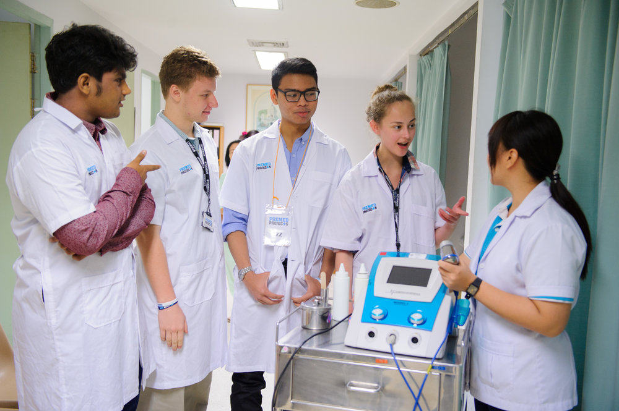
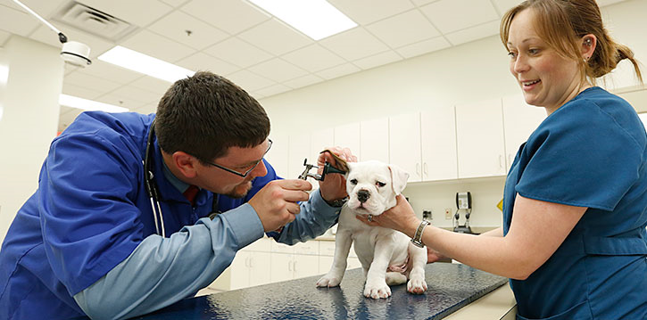
Evidence of relevant experience.
Work experience is vital
Very specific work experience needed for veterinary science
For medicine they are looking for commitment – e.g sustained voluntary work ideally working with people e.g the Cottage Hospital
Hereford hospital run a fantastic 2 day course for interested medics – apply after GCSE results as they only accept students with a strong set of results .

Slide 10

To Apply
You are only able to apply for 4 out of your 5 choices for these courses.
For the majority of medical courses you need to sit a UKCAT test in the summer of year 12 .
For some medical courses you need to sit a BMAT test in November of year 13 .

Slide 11
Medicine- Useful web sites
Leeds Medical School web site
Widening Access to Medical School (WAMS).
Royal College of General Practitioners
web site.
Liverpool and Newcastle Medical Schools web
sites.

Slide 12


Oxford & Cambridge (Oxbridge)Applications

Slide 13
Students from John Masefield Sixth Form
Recently students have gone on to study:
Music
Medicine
Engineering
Languages
Architecture

Slide 14


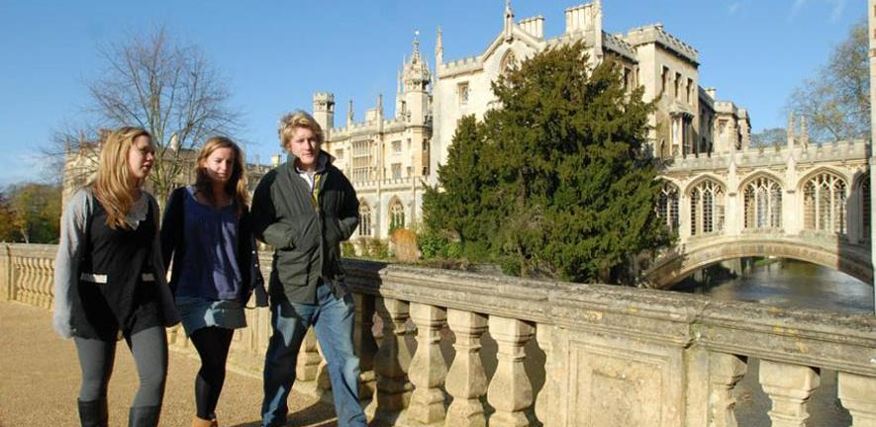
Will Oxbridge suit me?
Use the same rationale as for other universities.
Consider:
Your academic and wider interests
Entrance requirements and any ongoing grade requirements.
Course structure and content.
Types of assessment (Oxford and Cambridge assess more with traditional end of module / year exams)
Graduate prospects

Slide 15
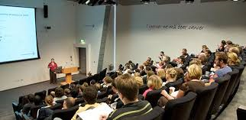
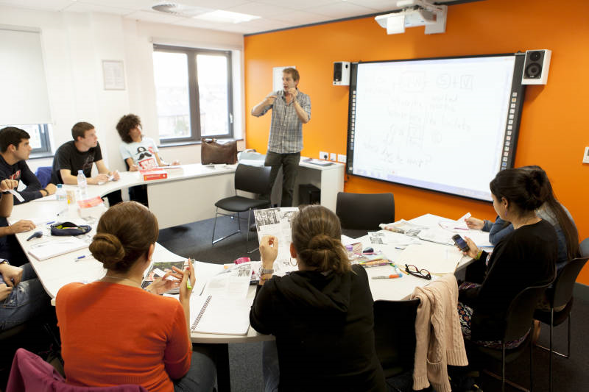
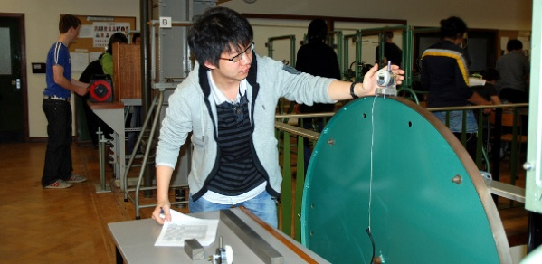
Academic Life
Terms are short (only 8 weeks!) and intense.
Lectures – larger group (30 to 200 people) Absorb, take notes.
Classes – Like lessons at our Sixth form and similar style .10-15 people.
Practicals – certain subjects only eg Biochemistry, Engineering.

Slide 16
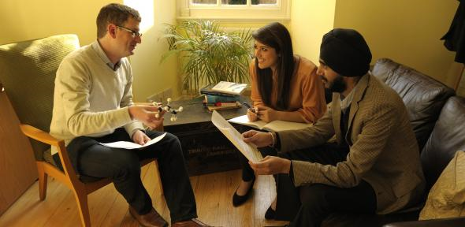
Tutorials
‘Tutorials’ (Oxford) ‘Supervisions’ (Cambridge)
Key selling point and differentiator for Oxbridge.
Intense 1 to 2 or sometimes 1 to 1 sessions.
An hour long and receive one or two per week.
Tailored to areas you need to focus on eg a particularly challenging problem /essay/text.
Forms the focus of a lot of independent study.
Can be with the people who wrote the books you have been reading!

Slide 17
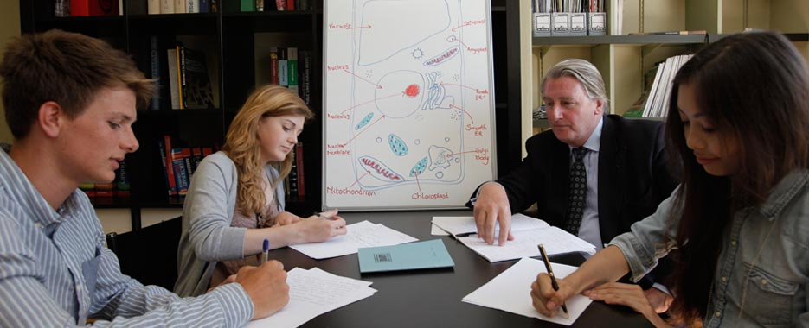

Contact time and independent study
Overall a working week is about 40 hours to succeed.
Typically in Year One 12-15 hours actual teaching (contact)per week depending on subject.
Rest made up of independent study (25-28 hours)
Self discipline and organisation are crucial!

Slide 18
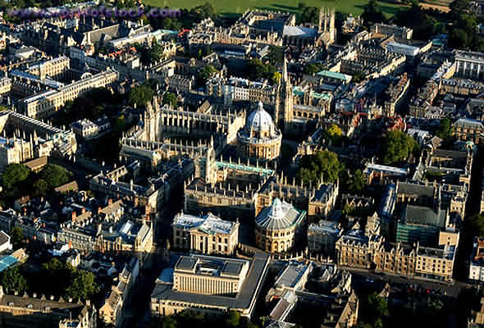
The College System
Oxford 35 Colleges and Cambridge 29 offering undergraduate study.
Different to other universities besides Durham.
Each College is like a mini-campus.
Academic buildings, accommodation, Social and Recreational areas.
Applications

Slide 19
The Oxbridge application cycle
Summer of Y12 (if not earlier) Choose course (more important than choice of College!)
Choose College or make open application.
Register for and sit any admissions tests /assessment eg LMat. By Mid October.
Apply by 15th October
Interviews in December
Decision in January (on average 1 in 6 applications made offer – varies with subject)
Oxford- Longer, more intense interviews, fewer interviews and offers, slightly lower grades.
Cambridge- More interviews given, shorter interviews, more offers but with higher grades.

Slide 20
The 4Rs for interview success
Right subject – know about it and why you are interested.
Excellent academic Record.
Read around the subject and think critically and analytically.
Revise and embed your learning from A Level as it will be tested.

Slide 21
What do Oxford & Cambridge say they are looking for.
Genuine interest in subject
Good fit between applicant and course.
Excellent academic record.(A Level & GCSE!)
Excellent core knowledge and technical fluency AT A LEVEL.
Focus, determination
Ability to think independently and critically.
Vocational commitment (Medicine /Vet.)

Slide 22
What Qualities are universities looking for?
‘’Students who stick up for themselves and stand out. A student who can address issues in a logical fashion and reason from premise to conclusion. Even if a student is hesitant or shy, how well they think will still be evident’’
Professor Thomas Noe, Oxford.

Slide 23
Support for your application at JMH6
Preparation from the start of Y12
A Medical Applications Programme.
An Oxbridge Applications Programme
Bespoke support and additional mentoring to meet all deadlines comfortably.
Strong support & guidance for writing first class personal statements.
.

Slide 24
Support for your application at JMH6
Practice interviews including Headteacher and outside specialists.
Support with gaining work experience if appropriate or summer school placements.
HE Plus Programme in association with Cambridge University.
Bursary & Placement opportunities with QinetiQ.
‘Widening access’ opportunities available to smaller school Sixth Forms.

Slide 25
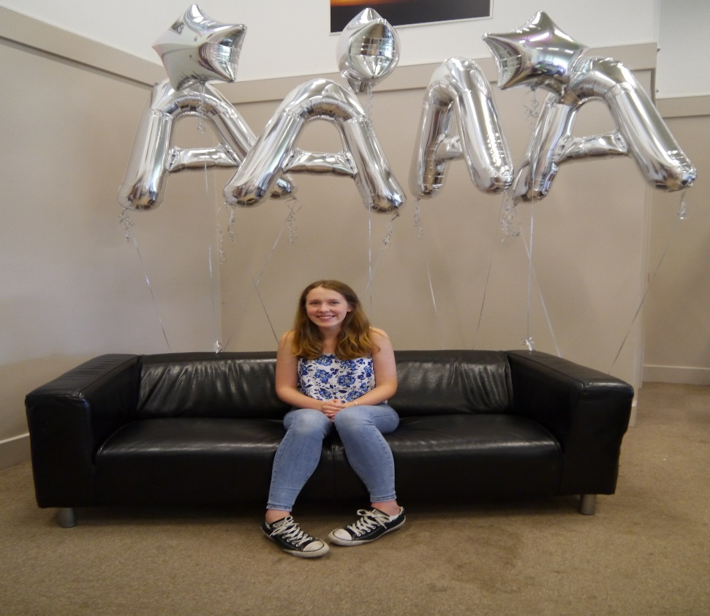
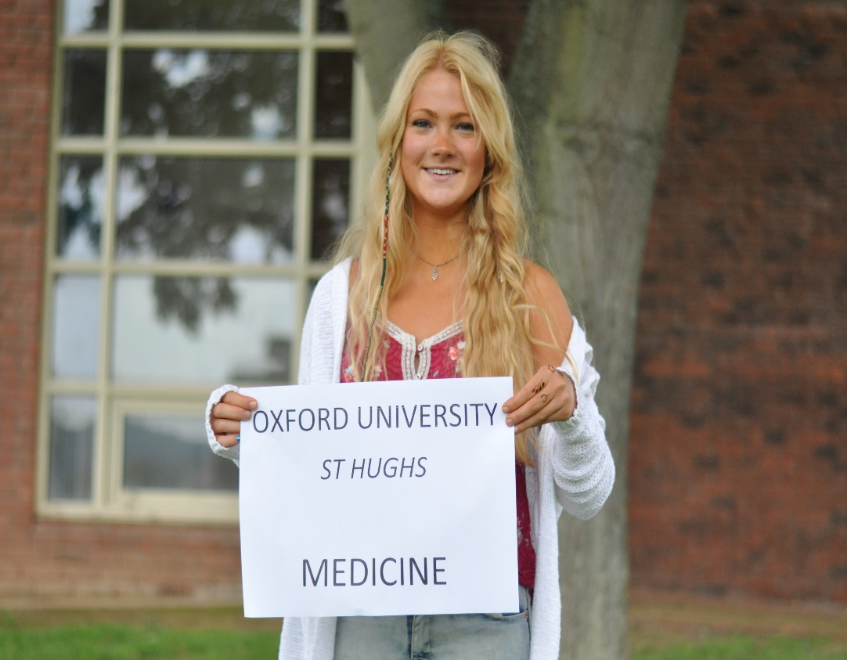
Don’t be put off – if it’s right for you
Students from JM6 go on to study at both Oxford and Cambridge.
In 2019/20 so could some of you!

Slide 26
Work Hard and Best Wishes
Hours in……… Grades out!

