Slide 1
Welcome to our
Key Stage 4 Courses Evening
Thursday 23rd January 2020
Notes:
1

Slide 2
New GCSEs- graded 1 to 9
1 = GCSE grade F/G
2 = GCSE grade E
3 = GCSE grade D
4 = GCSE grade C
5= GCSE grade C+ or B-
6= GCSE grade B
7= GCSE grade A
8= GCSE grade A*
9= Exceptional standard above GCSE A*

Slide 3
J Scale | GCSE Grade | Comment
3-5 | 1 | The lowest grade- F/G
6-8 | 2
9-11 | 3
12-14 | 4 | Equivalent to a low C grade
15-17 | 5 | New national expectation, just over 50 % nationally will achieve this grade across England
18-20 | 6
21-23 | 7 | Equivalent to an A grade
24-26 | 8
27-29 | 9 | Above an A* , about 2% nationally will achieve this grade across England
30+ |  | Beyond GCSE, at A-Level standard

Slide 4
Qualification types
A mixture of traditional and vocational qualifications
GCSE
9-1 Grades
BTEC Certificate
Distinction*-Pass (9-4)
Cambridge National Award
Distinction*-Pass (9-4)

Slide 5
The Year 9 Curriculum
Subject | Hours | Qualification
English | 4 | English and English Literature GCSE
Maths | 4 | Maths GCSE
Science | 4 | All students study Combined Science in Year 9
Language | 3/2 | Either French, German
Humanity | 3/2 | Either Geography or History
PE | 2
PSHE | 1 | Taught in two tutor times
RE/Citizenship | 1
Chosen subjects | 2 x 2 | GCSEs, BTECs, Cambridge National

Slide 6
Year 10 and 11 Curriculum
Subject | Hours | Qualification
English | 4 | English and English Literature GCSE
Maths | 4 | Maths GCSE
Science | 5 or 6 | Either GCSE combined science Or Biology, Chemistry and Physics
PE | 2
PSHE | 1 | Taught in two tutor times
Language | 2/3
Humanity | 2/3
Chosen subjects | 2 x 3 | GCSEs or BTECs

Slide 7
GCSE English
Examinations in English Language which will test reading and writing skills
There will be separate speaking and listening assessments
Examinations in English Literature will test understanding of poetry, prose and drama texts
Students take a GCSE in English Language and a GCSE in English Literature.

Slide 8
Science Options
Combined Science: (two GCSEs)
Studied over 5 lessons per week in years 10/11
Gives two (9-1) grades at the end of year 11
6 x 1hr 10 min exams in year 11
OR
Separate Sciences: (three GCSEs)
Each subject has 2 lessons per week
3 GCSEs studied over years 10 and 11 giving 3 (9-1) grades Biology, Chemistry and Physics
6 x 1hr 45 min exams in year 11
Both routes offer entry onto A-level science subjects.
Entry onto A Level subjects depend upon both grades and student effort/commitment.

Slide 9
Separate Sciences option
Commit to attending an after school lesson every Tuesday in Years 10 and 11 and extra homework each week.
Exams: 6 x 1 hour 45 minute exams (2 Biology, 2 Chemistry and 2 Physics) at the end of Year 11. This may make it more difficult for those who find writing for an extended time challenging.
All students are welcome to apply for the Separate Sciences however:
As this course is generally oversubscribed not all students will be offered a place. Places are decided by a combination of:
Effort in lessons and homework
Care and concentration shown in lessons
Attitude and commitment to extra study
Performance in extended exams in year 9

Slide 10
Any questions?
Your science teacher will be able to discuss with you the most suitable route to choose.
In addition the following staff can also help:
Mr Jennings, Faculty Leader
Miss Clayton, Assistant Faculty Leader

Slide 11
GCSE Maths
Examinations in Maths will test Number, Algebra, Data Handling, Shape Space and Measures
The exam is undertaken at the end of Year 11
Three papers of equal weighting, one of which is non-calculator
Two tiers of papers (entry confirmed in March Year 11)
  Foundation 5-1
  Higher 9-4

Slide 12
KS4 Course Form

Slide 13
Pathways
There will be two pathways, A and B
Pathway A – Students will follow the EBACC and be expected to aim for a minimum of grade 5 (equivalent to a C+/B-) in these subjects
Pathway B – Students will be offered the chance to do the EBACC but may find it more difficult to achieve a grade 5. There will be alternative choices if they wish not to study a language

Slide 14
Part A Compulsory Subjects
The KS4 Courses form 2020 – 2023 (Pages 29/30 of the options booklet)
All students will study the following courses:
English Language and English Literature
Mathematics
Science Combined (or separate sciences; Biology, Chemistry, Physics)
French, German (or an alternative)
Geography or History
and non-examination courses in RE/Citizenship (Year 9), PSHE and PE.
Notes:
* Some students may not study a language

Slide 15
Part B Chosen Subjects
Pathway A
In Box A you will choose French or German. If you wish to do two languages please choose French here, indicating the priority order.
In Box B you will choose Geography or History. If you wish to do two Humanities then choose History here, indicating the priority order.
Pathway B
In Box A you may choose French or German or indicate that you do not wish to study a language.
In Box B you will choose Geography or History

Slide 16
In Box C you make 3 choices in priority order (one is a reserve choice)
GCSE Art and design | GCSE Food Preparation and Nutrition*
Cambridge National Enterprise and Marketing | GCSE German (as a second language)
GCSE Computing | GCSE History (as a second Humanity)
BTEC Health and Social Care | GCSE Music
GCSE Dance | GCSE PE
GCSE 3D Design*
GCSE Drama | BTEC Travel and Tourism
Your order of preference is very important.
* Students can only study one technology option.

Slide 17

Box D
Students wishing to be considered for Separate Sciences must tick the box to confirm this.

Slide 18
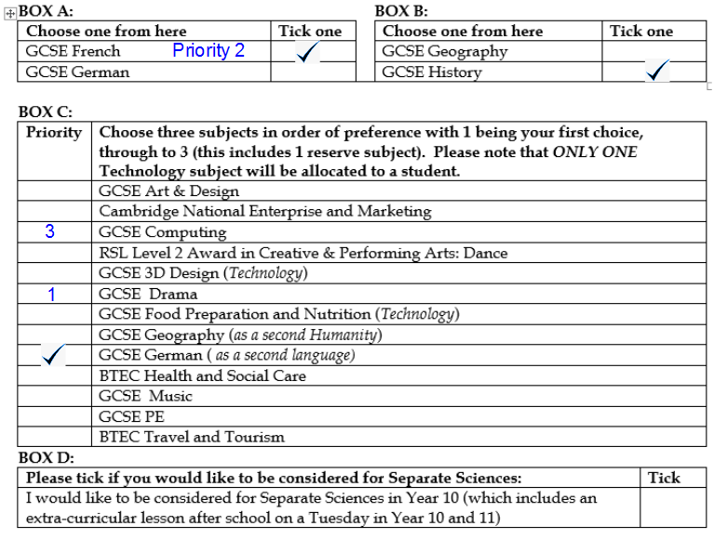

Slide 19
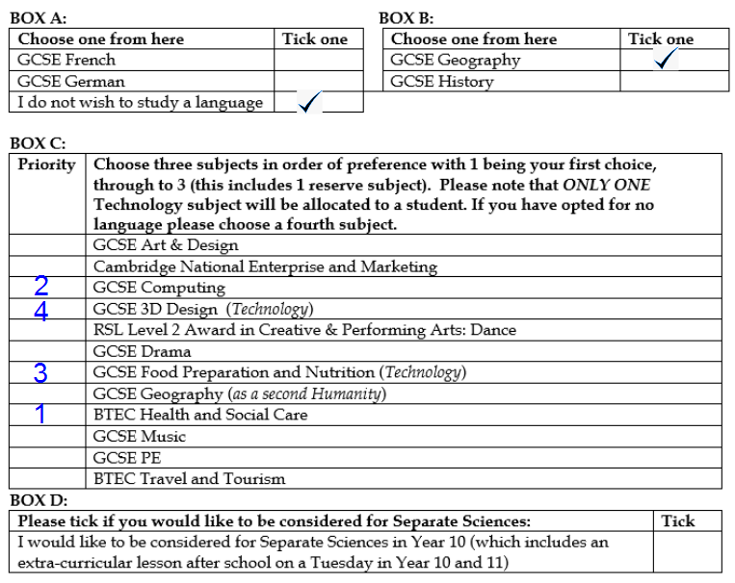

Slide 20
Subject Allocation
All student choices are considered at the same time.
Subjects are placed into timetabled blocks to maximise student Choices based on the combinations chosen
Pathway A block A will be at the same time as Pathway B block B and vice versa

Slide 21
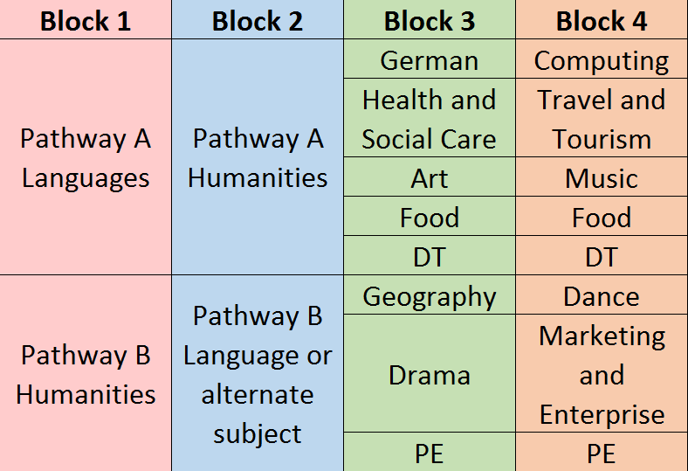
Subject Blocks
There will be four Subject choice blocks
The subjects in one block are all taught at the same time on the timetable
Example
Block 3 and 4 are just an example of what could happen

Slide 22
Timetable
A Year 9 timetable may look like this

Slide 23
Calendar of events
KS4 Course choice interviews will commence on Monday 27th January.
KS4 Course choice interview period | January 27th – February 7th
Y8 Parents Evening | February 6th
Deadline for submitting Course forms | February 7th
Y8 Progress Check | March 2nd
Initial Allocations sent home | Easter
Y8 Exam weeks | April 30th
Y8 Report | June 22nd

Slide 24



Choosing the right Courses
Where are you at right now?

Slide 25
Next steps
Information Gathering – sources of information:
Faculty Leaders
Teachers
Prefects
Other students
Parents
BUT remember all sources of information are biased. Information and experience serve as guidelines.

Slide 26
KS4 Course Choice Interviews
Interviews can be booked in the dining
room following this presentation.
Beacon – Mr Evans
Holywell – Mr Collard
Jubilee – Mr Williams
Midsummer – Mr Wyatt (a)/Mr Hammond (b)
Selected Students – Mrs Barker, Miss Newnes
Following this evening appointments can be booked over the phone.

Slide 27
Dispelling the Myths
1. Courses are first come first served.
2. No reserve choices = I get what I want.
3. I can change without my parents knowing.
4. If I don’t take… now, I won’t be able to study …. Later.
5. Taking … means I do less work.
6. If I do … I am guaranteed to do really well.
7. If I take … I am bound to get that teacher.
8. If my friends and I choose … we will all be together.

Slide 28
Why might I not get my course choices?
There is a change in the staffing structure of the school
There are insufficient numbers to run a course
There are too many students choosing one particular course
There is strong evidence to suggest this is not an appropriate choice

Slide 29
In Summary
Seek Opinions.
Listen to advice.
Ask the right questions.
Read the course booklet.
Select the courses that work for you.
Be ready to justify your choices at the interview!

