Slide 1
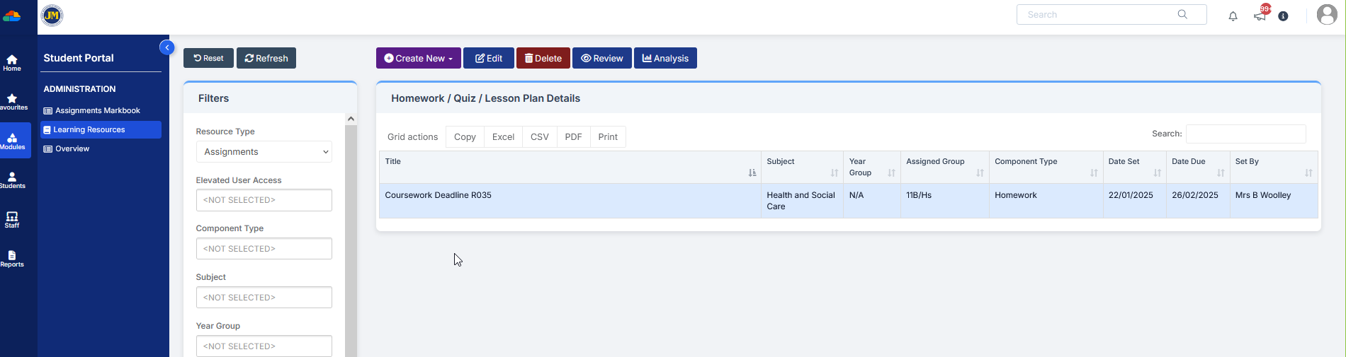
How to mark homework as submitted
If you have incorrectly set the submission type of homework as Online submission when it is not, they you need to mark the homework as submitted when you get the paper submission.
Go to
Modules/StudentPortal/Learning Resources
Select Homework you need to mark
And click Review

Slide 2
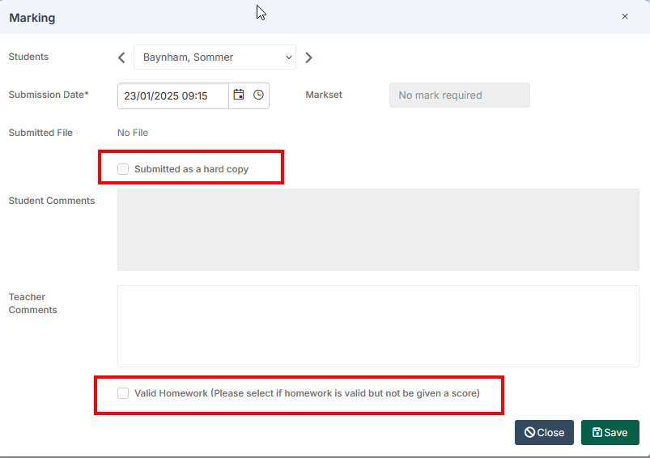
For each student tick the boxes:
Submitted as a hard copy
And
Valid Homework
And Save

Slide 3

It is possible to bulk mark homework
Instead of clicking Review, click the Analysis button (no need to select homework first)

Slide 4
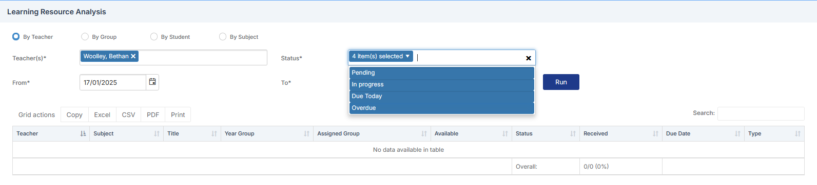
You need to choose the teacher and optionally select the status and the from and To dates to narrow down the list
Click Run to get a list of the homework

Slide 5
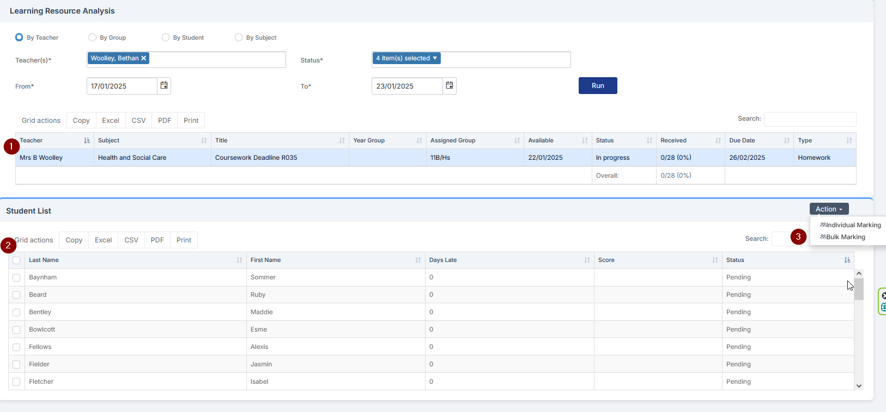
1. Click the homework you want to bulk mark
2. Then select the students. Clicking top box selects them all.
3. The select Bulk Marking from the Action dropdown.

Slide 6
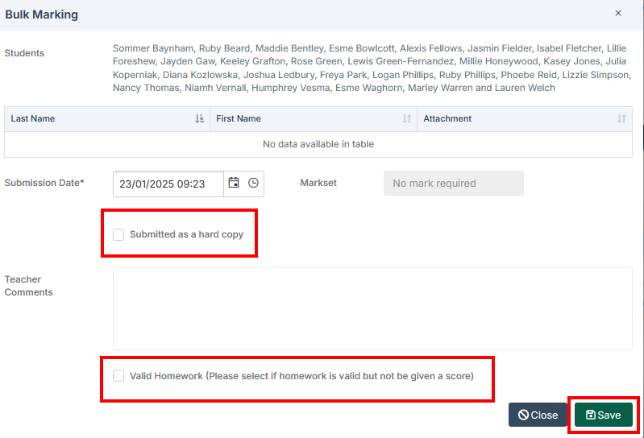
You can now click the
Submitted as hard copy and
Valid Homework
enter optional comments,
then Save
and all students you have selected will be marked.

