Slide 1
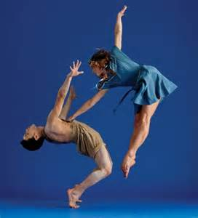
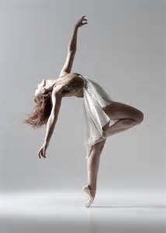
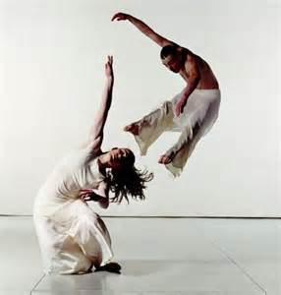
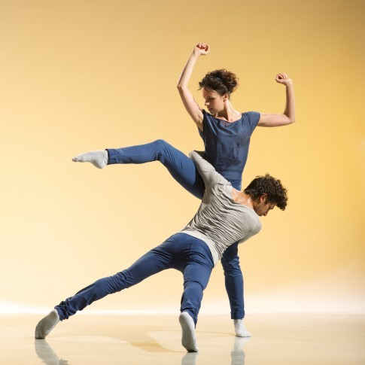
e EDUQAS DANCE
LEVEL 2 VOCATIONAL AWARD

Slide 2
Reasons to do Dance:
This creative and exciting subject offers students opportunities to experience a range of dance styles and explore a variety of skills.
Learning dance improves confidence and develops key skills including problem solving skills, discipline, teamwork and creativity. It helps to keep you physically fit and is fun.
Click to watch
This video

Slide 3
Year 9 – Transition Year
In year 9 you will have the chance to try a range of different dance styles and you will learn a variety of group dances to perform
The focus for this transition year will be on skills development in performance and choreography
You will also work on developing your knowledge of subject specific vocabulary and dance technique
You will have opportunities to go on theatre trips and perform in shows and competitions

Slide 4
Benefits of the vocational course
No written exams
Lots of practical work
Choice of styles
Accessible
Fair assessment

Slide 5
The Course
We could do any of these dance styles
Unit 1 Perform
Internally assessed
Research different musicals
Plan a performance
Perform dances / act scenes in a group.
Evaluate your performances
30% OF YOUR FINAL GRADE

Slide 6
Unit 2 - Choreography
Internally assessed
In year 10 you will be given a stimulus as part of your brief to respond to.
You will research the stimulus and use it as a starting point to create either a solo/group choreography.
To accompany your choreography you will write a production plan, rehearsal schedule and rehearsal logs. You will need to write about health and safety in your planning.
Your final task of the controlled assessment will be to write an evaluation of your final performance.
30% OF YOUR FINAL GRADE

Slide 7
Unit 3 – Performing Arts Practise
EXTERNALLY ASSESSED BY THE EXAM BOARD
Completed in year 11
Propose ideas for a performance in response to a commission
Plan and perform a solo or group dance
Promote, market and pitch your performance
Evaluate your work

Slide 8
Key knowledge Breakdown…
Performance
Appreciation
Choreography
Physical Skills
Technical Skills
Expressive Skills
Mental Skills
Safe Practice
RADS
Process of creating
Structuring
Devices
Aural setting
Choreographic intent
Production
Performance environments
Choreographic approaches
Choreographic content
Choreographic intent
Performance environments
Choreographic Intent

Slide 9
GRADES
L1 PASS – EQUIVALENT TO GRADE 1
L1 MERIT – EQUIVALENT TO GRADE 2
L1 DISTINCTION – EQUIVALENT TO GRADE 3
L1 DISTINCTION* – EQUIVALENT TO GRADE 4
L2 PASS – EQUIVALENT TO GRADE 5
L2 MERIT – EQUIVALENT TO GRADE 6
L2 DISTINCTION – EQUIVALENT TO GRADE 7
L2 DISTINCTION*– EQUIVALENT TO GRADE 8

Slide 10
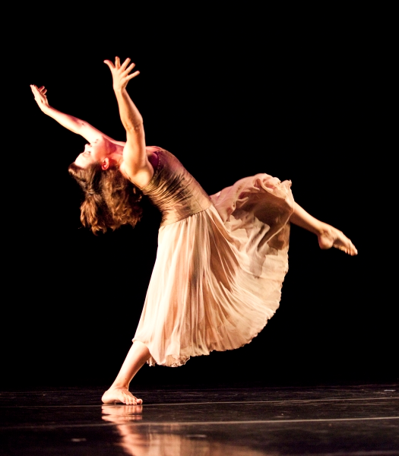
Success Tips
Watch as much live dance as you can.
Do independent research into professional Dance.
Make sure you are well organized with homework and kit.
Communicate well with your peers.
Any questions?
Amy.Goodall@jmhs.hereford.sch.uk

