Slide 1
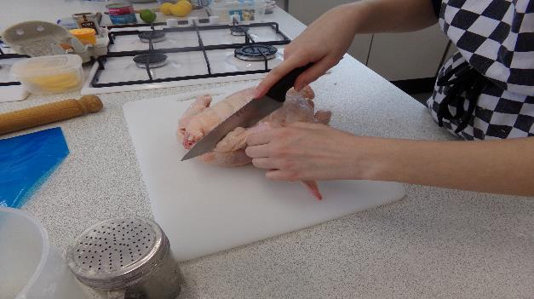
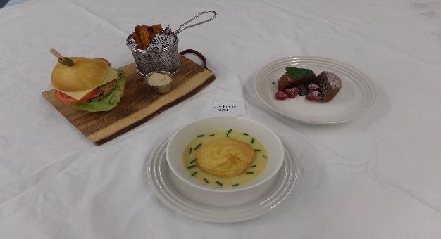
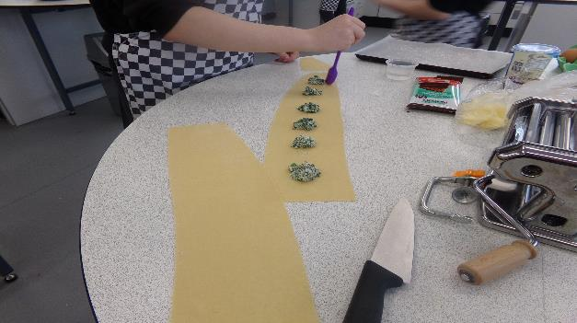
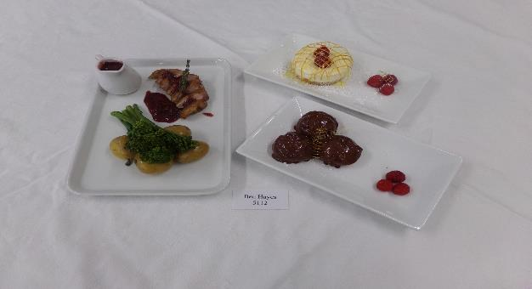
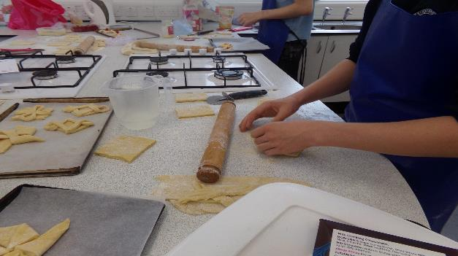
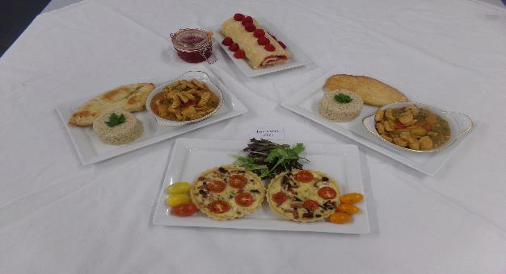
GCSE Food Preparation and Nutrition

Slide 2
Food Preparation and Nutrition GCSE
This course will equip students with the knowledge, understanding, and skills required to cook and apply the principles of food science, nutrition and healthy eating.
It will encourage students to cook and develop vital life skills that enable them to feed themselves and others affordably and nutritiously, now and later in life.
It will enable them to make informed decisions about a wide range of further learning opportunities and career pathways

Slide 3
Year 9 Food
Topics covered:
Food sustainability
Commercial food production
Kitchen Hygiene
Functional properties of food
Sugar – uses in cooking/Dietary issues
Diet and Health
The Hospitality industry
Job roles
Dietary needs
Menu design and function planning

Slide 4
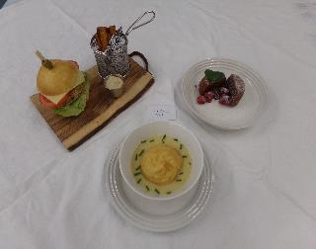
Food Preparation and Nutrition GCSE
Course content:
Food commodities
(1.Fruit & Veg, 2. Meat, Fish, Poultry and Eggs 3. Milk, Cheese and Yoghurt 4. Cereals 5. Soya, Tofu, Beans, Nuts and Seeds 6. Butter, Oil, Margarine, Sugar and Syrup)
Principles of nutrition
Diet and good health
The science of food
Where food comes from
Cooking and food preparation

Slide 5
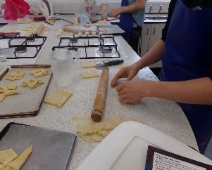
Skill level
Higher Level Skills:
• Pastry making – short crust, pate sucre, choux.
• Roux based sauces
• Meringues and pavlovas
• Meat and fish cookery (using high risk foods and butchery skills)
• Decorated cakes and gateaux
• Rich yeast doughs
• Complex accompaniments and garnishes
Medium Skills:
• Puff pastry items that need shaping but use ready-made pastry.
• Vegetable and fruit dishes requiring even sizes e.g. fruit salad,
stir fry showing competent knife skills
• Cheesecakes and similar desserts.
• Simple sauces e.g. red wine sauce.
• Simple cakes, biscuits, cookies and scones.
• Basic bread doughs.
Basic Skills:
• Crumbles.
• Sandwiches.
• Pizza with ready-made base.
• Jacket potatoes.
• Simple salads.
• Assembling products e.g. using prepared sauces,
bought meringue nests, etc.

Slide 6
Food Preparation and Nutrition GCSE
Summary of Assessment
This course is broken down into two components:
Component 1: Principles of Food Preparation and Nutrition.
Written examination: 1 hour 45 minutes 50% of qualification
Section A: questions based on stimulus material.
Section B: structured, short and extended response questions to assess content related to food preparation and nutrition.
Component 2: Food Preparation and Nutrition in Action.
Non-examination assessment. Internally assessed, externally moderated
Assessment 1: 8 hours 15% of qualification
Assessment 2: 12 hours 35% of qualification

Slide 7
Food Preparation and Nutrition GCSE
Component 2 Non Examined Assessment (NEA) tasks
Assessment 1: 8 hours 15% of qualification
Task 1:
Sugar is a main ingredient in cakes; however, as a nation we are encouraged to consume less sugar. Investigate the working characteristics and the functional properties of sugar as an ingredient for cakes. Research whether it is possible to reduce the sugar content or use alternative ingredients without adversely affecting the result.
Or Task 2:
Vegetables are an important commodity in the diet and can be served in many ways. Investigate the best methods of preparing, cooking and serving vegetables to retain their maximum nutritional content, colour and texture.
Assessment 2: 12 hours 35% of qualification
Task1:
Street food is becoming more popular in this country and can be found not only at organised events but increasingly in the streets of our towns and cities. Research prepare and cook 3 dishes (and accompaniments, if appropriate) that demonstrate your technical skills and show the best of Street food in Britain at an event of your choice.
Or Task 2:
A local garden centre café wants to update its traditional children’s menu to include dishes that are healthier, innovative and more appetising.
Research, prepare and cook three dishes (with accompaniments, if appropriate) that demonstrate your technical skills and meet the new menu requirements.

Slide 8
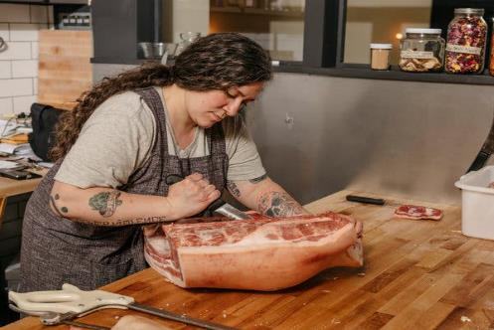
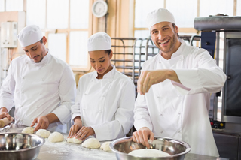
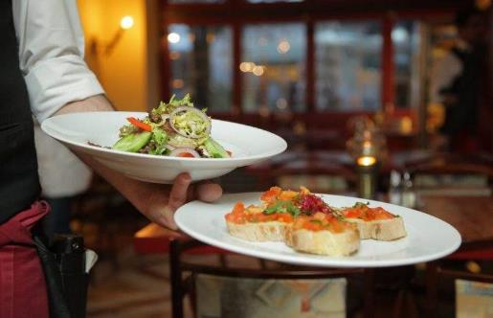
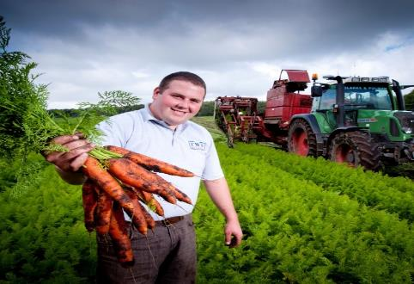
Further Education and Careers in Food

Slide 9
Courses at Hereford and Ludlow College https://www.hlcollege.ac.uk/course-category/580f774704167/Hospitality-Catering-Courses

Slide 10
Examples of apprenticeships that relate to Food
Food technologist - Level:3 (equivalent to A levels at grades A to E). Typical length:36 months
Food and Drink Advanced Engineer - Level:6 (equivalent to bachelor's degree). Typical length:60 months
Food and drink maintenance engineer - Level:3 (equivalent to A levels at grades A to E). Typical length:36 months
Advanced butcher - Level:3 (equivalent to A levels at grades A to E). Typical length:22 months
Catering and Professional Chefs: Professional Cookery - Level:2 (equivalent to GCSEs at grades A* to C). Typical length:18 months
Commis chef - Level:2 (equivalent to GCSEs at grades A* to C). Typical length:12 months
Senior chef production cooking - Level:3 (equivalent to A levels at grades A to E). Typical length:12 months
Hospitality team member - Level:2 (equivalent to GCSEs at grades A* to C). Typical length:12 months

Slide 11
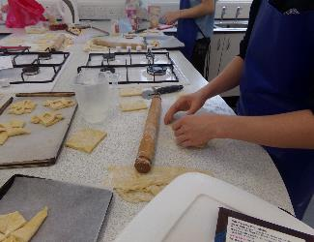
Food Preparation and Nutrition GCSE
Skills and Qualities:
In order to be successful on this course it is important that you:
Have an interest in what is going on around you in the world and in your local area
Enjoy research and investigation
Work consistently hard
Take responsibility for your own learning.
You should be keen and motivated enough to work hard without being continually monitored
Meet deadlines, particularly for completion of the board set assessment tasks
Are organised and keep good notes from the start of the course
Have excellent attendance
Roger Oaten:
roger.oaten@jmhs.hereford.sch.uk

