Slide 1
GCSE Geography
I hope that this presentation gives you all of the information you need to make your GCSE option decisions.
If you have any questions after the presentation please email me at:
ami.phillips@jmhs.hereford.sch.uk
Miss Phillips

Slide 2
GCSE Geography - Assessment
Paper 1 Global Geographical Issues 37.5% of GCSE 1 hr 30 | Paper 2 UK Geographical Issues 37.5% of GCSE 1 hr 30 | Paper 3 People and the environment: Making Geographical Decisions 25% of GCSE 1hr 30
Hazardous Earth Development Dynamics Challenges of an urbanising world | UK’s evolving human landscape UK’s evolving physical landscape Fieldwork | People and the biosphere Forests under threat Consuming energy resources
The questions will involve a series of short mark answers including graph skills, numeracy and factual recall.
There will also be extended writing questions in all three papers.

Slide 3
GCSE Geography – course layout
Yr9 – building blocks for GCSE | Yr10 | Yr11
How do we approach geographical enquiry? | Why does global inequality exist? | Why are coastal settlements at risk?
How diverse is Asia? (A mixture between human and physical geography). | How has globalisation changed India? Fieldwork: Who has the regeneration in Worcester benefitted? | How diverse is our planet? What threats do global forests face?
How have past processes shaped the landscape? | Why are some tectonic hazards more deadly than others? | How and why is energy use changing? Unseen fieldwork
How does a river change as it travels towards the sea? | What challenges do cities face? | Review and revision
Why is the UK’s human landscape changing? | Is the world becoming more dangerous? Climate change and tropical storms. | Review and revision
Why is London changing? | Fieldwork: Why is Tewkesbury at risk of flooding?
TERM 1
TERM 2
TERM 3
GCSE course content will not start at the beginning of Year 9. Year 9 is a transitional year which provides the building blocks for GCSE.

Slide 4
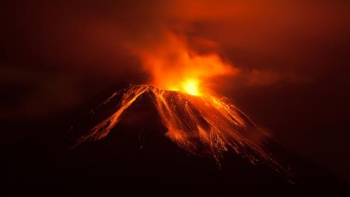
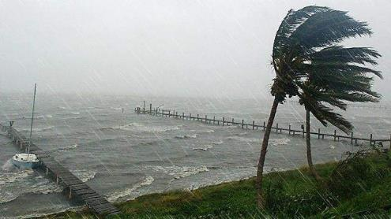
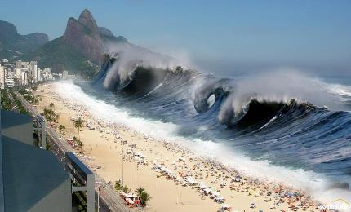
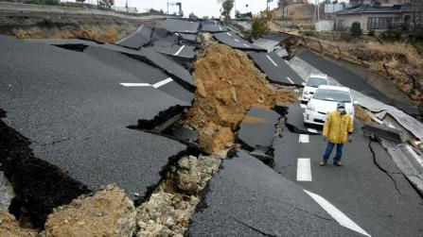
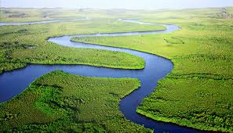
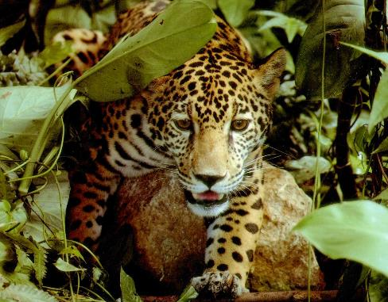
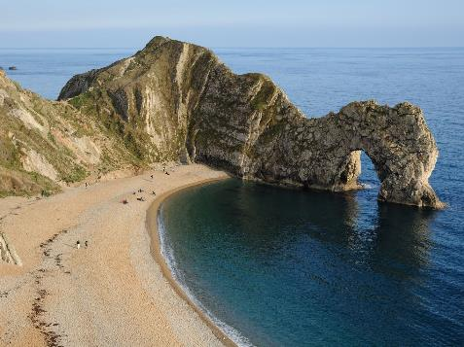
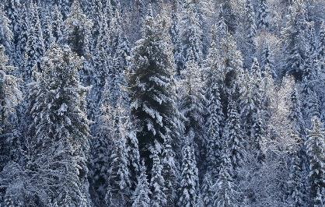
What will you learn? Physical geography
Tsunamis
Tropical storms (hurricanes)
Volcanoes
Rivers and flooding
Earthquakes
Coasts
Biomes (tropical rainforest and taiga)

Slide 5
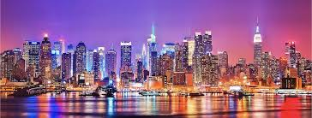
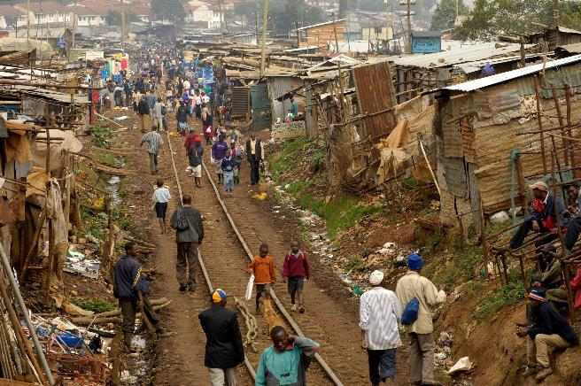
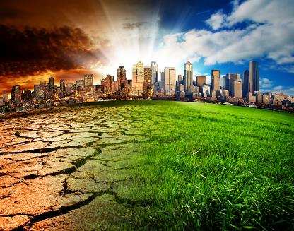
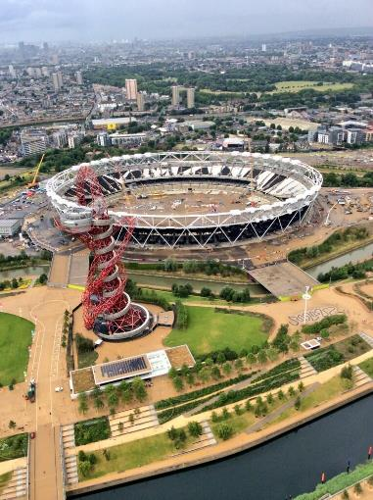
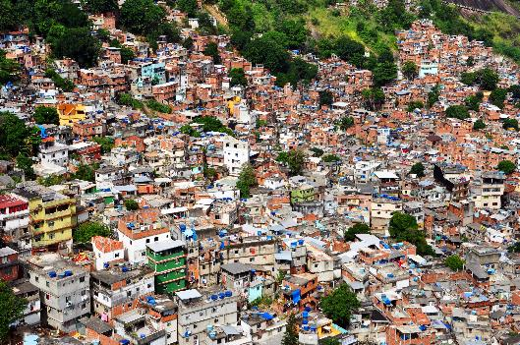
What will you learn? Human geography
Urbanisation
Development
Globalisation
Climate change
Regeneration
Energy

Slide 6
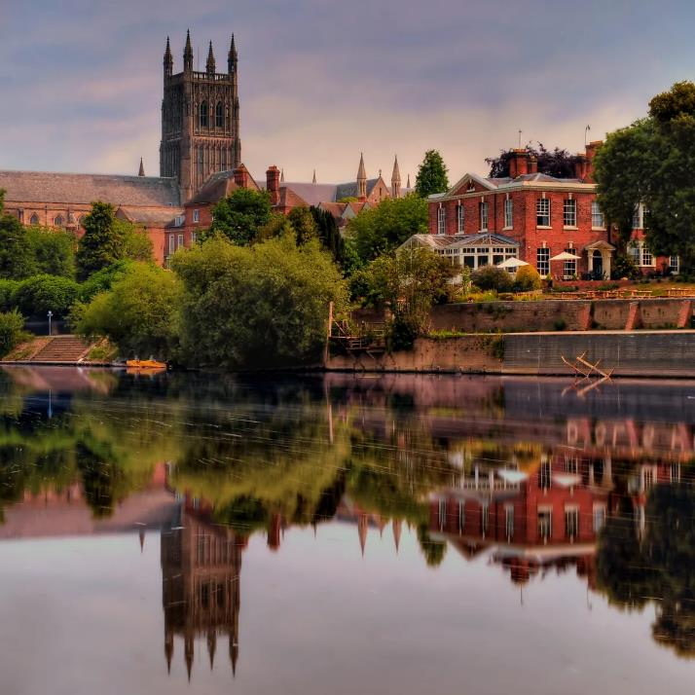
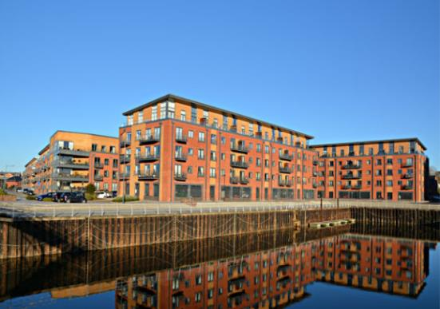
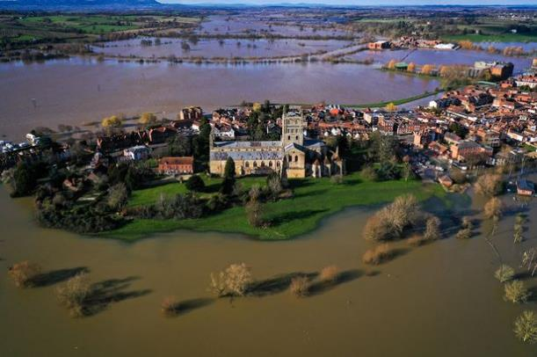
Fieldwork
Human fieldwork: regeneration in Worcester
Physical fieldwork: flooding in Tewkesbury

Slide 7
