Slide 1
CAMBRIDGE NATIONAL CERTIFICATE
HEALTH AND SOCIAL CARE

Slide 2
What is Health and Social Care?
Health & Social Care is a vocational course that helps students understand how care is provided in society across a range of sectors.
It develops students’ empathic skills and fosters a sense of understanding and respect for others.
This course provides students with an introduction to the world of Health and Social Care, allowing them to understand the principles of quality care in action.
Students will explore a variety of aspects ranging from health specialist pathways, social care specialism and early years.

Slide 3
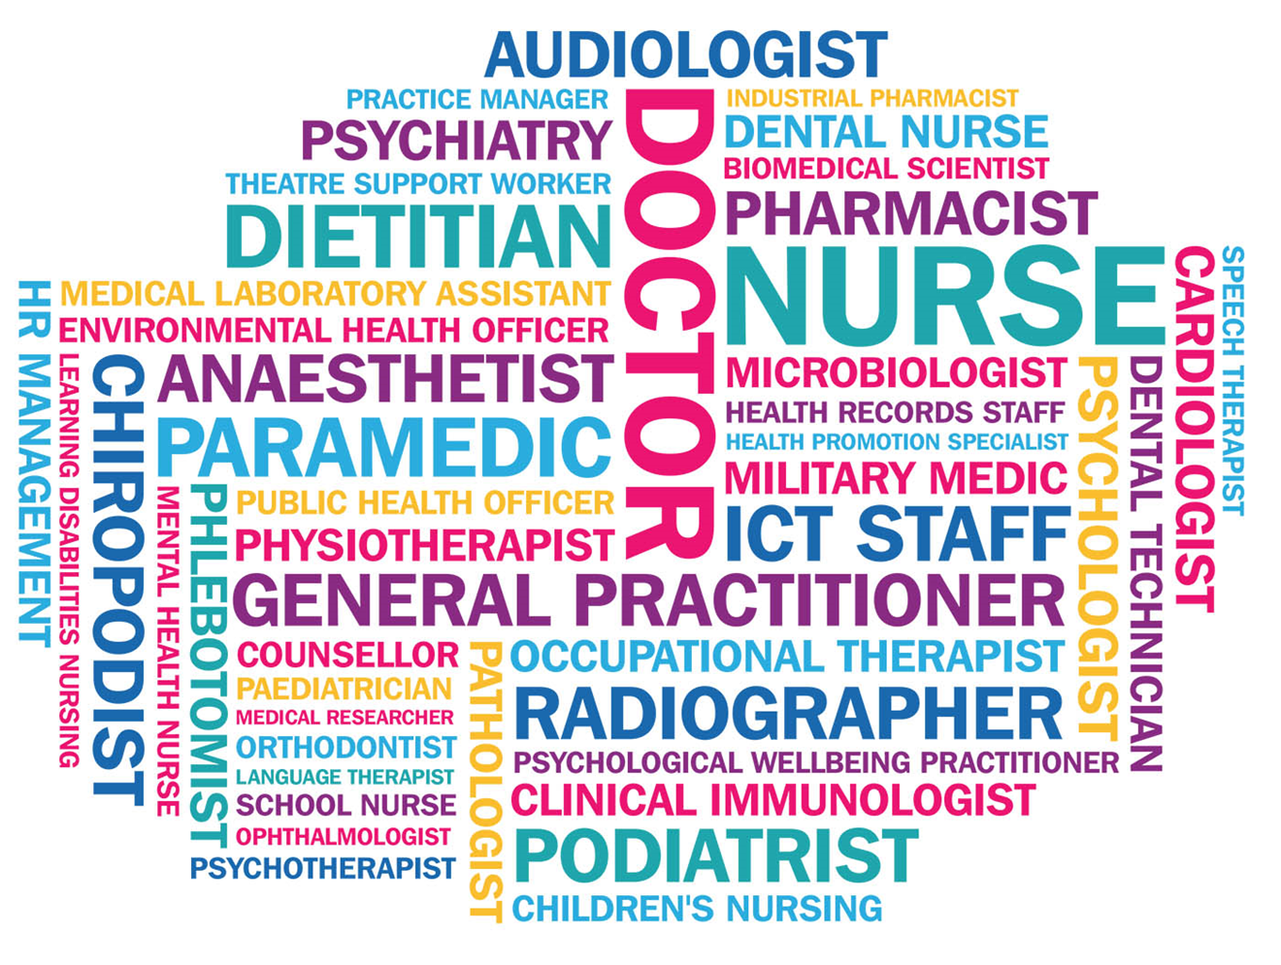
About three million people in the UK work in the health and social care sector - the equivalent to one in every 10 people. Demand for both health and social care is liable to continue to rise due to the ageing population, and so will play a very important role within the UK society. With this, there will be a greater demand for people to work in these roles.
Social Care Careers
Health Care Careers
social worker nanny yoga therapist family support worker care home assistant music therapist occupational therapist
nursery assistant family mediator carers to help dressing and washing bereavement counselling play therapist reflexology child minding mental health counselling pre school teaching
Art therapist drama therapist mental health support nutritional therapist

Slide 4
The Cambridge National in Health & Social Care aims to equip students with both the practical skills and the knowledge behind working within this demanding spectrum of subjects. The course allows students to develop essential knowledge of the work place alongside transferable and personal skills.
During the course, students are expected to complete two pieces of externally moderated coursework as well as one external exam.
Coursework units include:
Core Unit:
Supporting Individuals through life events
Optional Unit, either:
Creative and therapeutic activities
Health promotion campaigns
Exam Unit: Principles of care in health and social care settings
The exam is one hour long and involves both short and long answer questions.
Students starting the course in Year 9 will take the exam in the January of Y11 with the option to retake in the Summer of Year 11.
The three units make up the final grade, which is awarded at Pass, Merit and Distinction level.

Slide 5
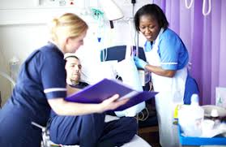
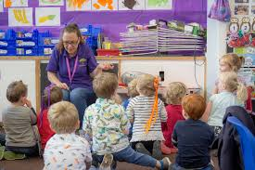
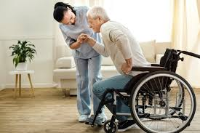
R032 Principles of Care in Health and Social Care Settings This is the examined unit
In this unit you will learn about the key topics that are important when caring for and protecting people in health and social care. Topics include:
The rights of service users in HSC
Person centred values
Effective communication in HSC
Protecting service users and service providers in HSC settings

Slide 6
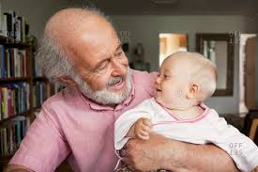
R033: Supporting Individuals through life events This is the mandatory coursework unit
In this unit you will learn about growth and development through life stages. You will also learn how to understand the needs of individuals who have been affected by life events and how to recommend support to meet their needs. Topics include:
Life stages
Impact of life events
Sources of support

Slide 7
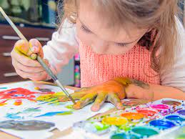
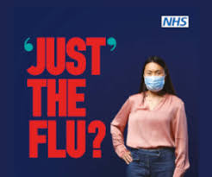
R034 Creative and Therapeutic Activities This is the optional coursework unit
In this unit you will research therapies and learn how they can benefit people. You will also learn about the benefits of creative activities and you will plan and deliver a creative activity to a group or individual.
R035 Health promotion campaigns This is the optional coursework unit
In this unit you will research health promotion campaigns and learn about their benefits to society. You will also plan and deliver your own health promotion campaign

Slide 8
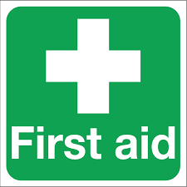
What will I study In Year 9?
Year 9 is all about building a solid knowledge of what Health and Social Care is and creating a firm understanding of the different settings, users and professional involved. Students will have the opportunity to complete two practical courses, these are:
First Aid – students complete a module on basic first aid and then will have the opportunity to achieve a first aid qualification.
BSL – Students will complete a basic British sign language course so they are able to understand the basics of sign language as a way to communicate.

Slide 9
Post 16 Options
At John Masefield we offer the Cambridge Technical Award in Health and Social Care which is equivalent to one A-Level. If you have studied Health and Social Care in KS4 you will find the transition to the Technical Award a smooth process as you will build on what you have already learnt. The Technical award is linked to many university courses and apprenticeships in this sector.

