Slide 1
GCSE Religious Studies
Any further questions, please email me at:
emily.harris@jmhs.hereford.sch.uk

Slide 2
What will I study?
The course consists of two components:
An in-depth study of two religions
Four philosophical and ethical ‘themes’
Notes:
There are two papers that we will be working towards. The first one is the in-depth study of two religions. I’ve chosen two Eastern faiths – Buddhism and Sikhism.
Buddhism because it is increasingly popular in this country, with lots of people looking to its outlook on the world and finding it speaks to them in a way their busy, Western lives do not. The other is Sikhism – lots of reasons for this, but the fundamental principles of equality as well as a duty to defend the weak and vulnerable lead to it having some really interesting perspectives on the issues we study in paper 2.
In paper 2 (which is usually the one people get most excited about, and is definitely the one I really love teaching) is the philosophical and ethical themes. My undergraduate degree was in philosophy, so I might be a bit biased, but I think it is such a unique opportunity for you as individuals to grapple with the really big questions in life, things that you will definitely need an opinion on when you go out in to the world, but that maybe you don’t get to explore as much anywhere else. We will look at religious and non-religious perspectives on issues as wide-ranging as abortion, nuclear weapons and the death penalty, and help you to articulate your own opinions about them, as well as be sensitive and empathetic to the views of others. If you enjoy a debate, this is definitely going to be the subject for you!
The papers themselves have a really clear layout, which starts with a nice and easy multiple choice question to warm you up. It will then ask you to recall slightly more complex information, apply religious teachings to a topic and the 12 mark question asks you to analyse a particular viewpoint, giving points in favour, those that oppose the statement as well as your own conclusion. Like all Humanities, RE does involve a fair bit of writing, but the expectations are fair and allow you to show what you’ve learned as well as present a coherent and persuasive argument, something that is so valuable as you will move on to further academic study or into a career.

Slide 3
Buddhism
The life of the Buddha
Meditation
Festivals
Different types of Buddhism
Karma
The Noble Eightfold Path
Notes:
So, let’s get into a bit more detail about what we will study.
In Buddhism, we will look at beliefs Buddhists have about karma and the nature of life and suffering as taught by the Buddha himself. We will also look at practices such as festivals Buddhists celebrate and even try out some meditation for ourselves.

Slide 4
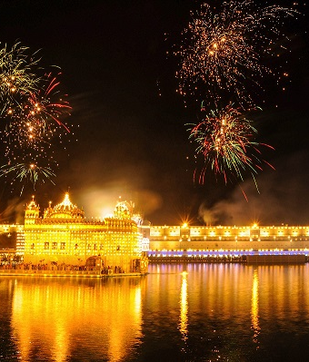
Sikhism
The lives of the Gurus
Sikh festivals
Equality
Khalsa
Five Ks
Sewa
Notes:
Sikhism is the youngest of the major religions and has some quite radical views about the equality of all – between genders and religions for example, and completely rejects the Indian caste system, which divided people in a hierarchical societal system and subjected the lowest caste the ‘untouchables’ to awful persecution. Guru Nanak, the first Guru led by example in rejecting it, and this was emphasised further by the other Gurus. Guru Gobind Singh, for example, introduced the tradition of giving Sikh men the name Singh and women the name Kaur, to disguise any previous ties to caste and emphasise that all were equal before God.
We will look at the ideas of Khalsa Sikhs as ‘Saint Soldiers’ and the impact they have made to Indian and British society, particularly fighting alongside the British in the World Wars.

Slide 5
Theme B: Religion & Life
Origins of the Universe
Science & Religion
Animal Rights
Abortion
Euthanasia
Notes:
Our first philosophical and ethical theme coves some pretty profound questions. We consider different explanations for the origins of the universe, and whether science and religion can ever be compatible. In animal rights we’ll look at eating meat and animal products, as well as animal experimentation. Animal experimentation particuarly was something I thought I had a very clear idea about – I thought there could never be enough justification – but I think I’ve moved on that slightly as I’ve researched more and more about it. I hope through studying RE at GCSE you’ll feel just as challenged and keep your minds open about the issues we will cover.
Then we look at two very sensitive issues – the question of when life begins and the ethical implications of abortion; and euthanasia, a practice increasingly being legalised around the world – as yet, still totally illegal in the UK. This is helping someone with a terminal illness to die, in order to relieve their suffering. It’s a tough topic, but an increasingly important one to consider, given our ageing population. Who should and who should not have a say in decisions of life and death? The individual? Families? Doctors? Religions? Government? There are no easy answers.

Slide 6
Theme D: Religion, Peace & Conflict
War
Religion as a cause of war
Terrorism
Nuclear weapons
Pacifism
Notes:
One of the most common things said to RE teachers (not by you lovely lot considering it, obviously!) that religion is the biggest cause of conflict around the world, and we’d be better off doing away with it entirely.
We’ll consider whether there are any justified reasons for thinking this, by looking at religious conflicts through history, such as the Crusades. We’ll also look at some incidents of modern terrorism, which seek to use religion as justification for abhorrent and indiscriminate killing of innocent people. We’ll discuss the idea of Jihad, and why those who claim to be acting in pursuit of Jihad are very much misguided and exploiting religion for their own, much more political aims.
We’ll also look at pacifism, the idea that violence is never justified. In this topic we get to look at the example of Quakers (my favourite Christians as you’ve all heard!) and the concept of conscientious objection to war.

Slide 7
Theme E: Religion, Crime & Punishment
Reasons for crime
Aims of punishment
Corporal punishment
Death penalty
Forgiveness
Notes:
In this theme we’ll look at why people commit crimes and how they’re treated when they do – consider what prisons are like, and whether in the modern age they are able to provide any real rehabilitation for the people inside them. We’ll look at corporal punishment – thankfully not used in the UK today, but it is elsewhere – that’s physically punishing a person for wrongdoing – in some cases this can be as extreme as chopping off body parts! And we will consider the death penalty, again, outlawed in this country, but practised around the world.
The last one on the list here is forgiveness, and weirdly, I think one of the most fascinating ones to consider. I’ve come to think of forgiveness as something incredibly brave and strong a victim can chose to do – for themselves, as well as the person who has hurt them. Letting go of the anger they feel inside can free them and lessen their own suffering – something again, I’m not sure I could always do.

Slide 8
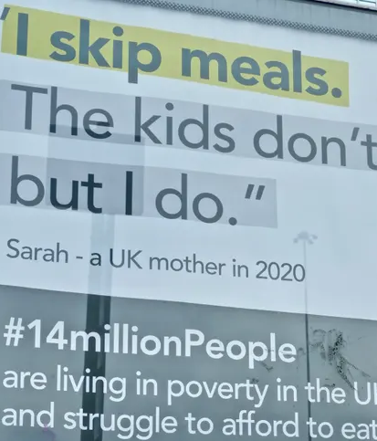
Theme F: Religion, Human Rights & Social Justice
Wealth & inequality
Human Rights
Charity
People trafficking
Prejudice & discrimination
Notes:
As you can see by the poster used on this slide, this final theme is a very current one to consider, during the cost of living crisis we are all facing at the moment. We look at ways the poorer in society are exploited or taken advantage of, and who has the responsibility to help. We’ll also cover racism, gender roles and inequalities as well as ways society has tried to ensure the ‘Golden Rule’ all religions share: treat others as you’d wish to be treated.

Slide 9
Where can Religious Studies take me?
Religious Studies helps to develop empathy, understanding and critical thinking. It is a subject for people interested in the people we share the planet with. So anywhere!
Notes:
RE is about religion, of course – but mainly it’s about people. By studying RE you are preparing yourself for life in modern, diverse Britain (as well as further afield). Whatever your chosen path, I believe RE will be valuable to you.

Slide 10
A new course for JMHS
What Religious Studies is NOT:
Only for those with a religious faith
A ‘soft’ or an ‘easy’ option
Biased or coercive towards any one faith
Notes:
I think this slide speaks for itself. RE sometimes gets some bad press, but I feel passionately that RE is for everyone, and I really hope you’ll choose to study it further at GCSE.

Slide 11
GCSE Religious Studies
Any further questions, please email me at:
emily.harris@jmhs.hereford.sch.uk
Notes:
If you do have any questions about the course, please come and see me in HU2 – alternatively, my email address is on this slide.

